Slide 1
TN CULTURAL CONNECT
ANANYA N (210701027)
ASHIK MOHAMMED Y (210701035)

Slide 2
Develop a digital platform to preserve endangered indigenous heritage, fostering cross-generational dialogue, and revitalizing diverse cultural elements amid modern challenges.
PROBLEM STATEMENT

Slide 3
SOLUTION
We've developed a multi-user admin website dedicated to showcasing and advocating for the endangered cultures of Tamil Nadu.
Through this platform, users can contribute content, fostering awareness and appreciation for Tamil Nadu's diverse cultural heritage.
It serves as a hub for promoting dialogue and understanding about these endangered traditions of the state like art, dance, music and food.

Slide 4
EXISTING SYSTEM
There are static websites for the content and information.
Government has also has website implying the importance of our culture promoting heritage and tourism.
Social media platform is utilised for displaying the artforms performed by individuals.
There is no particular hub specifically designed for
showcasing skills.

Slide 5
PROPOSED SYSTEM
Developing a platform specifically focussing on cultural artforms of the state so that they are seen.
Providing users the ability to like and comment on the contributor’s post.
Featuring most liked and commented post encouraging the
contributors.
Providing E-commerce site for paintings and
booking site for the events.

Slide 6
TECH STACK
HTML,CSS
JAVASCRIPT
PHP
MySQL

Slide 7
Modules
Admin and user authentication
Post management
Admin panel
Filter features
Category management
E-commerce and booking
Information and content

Slide 8
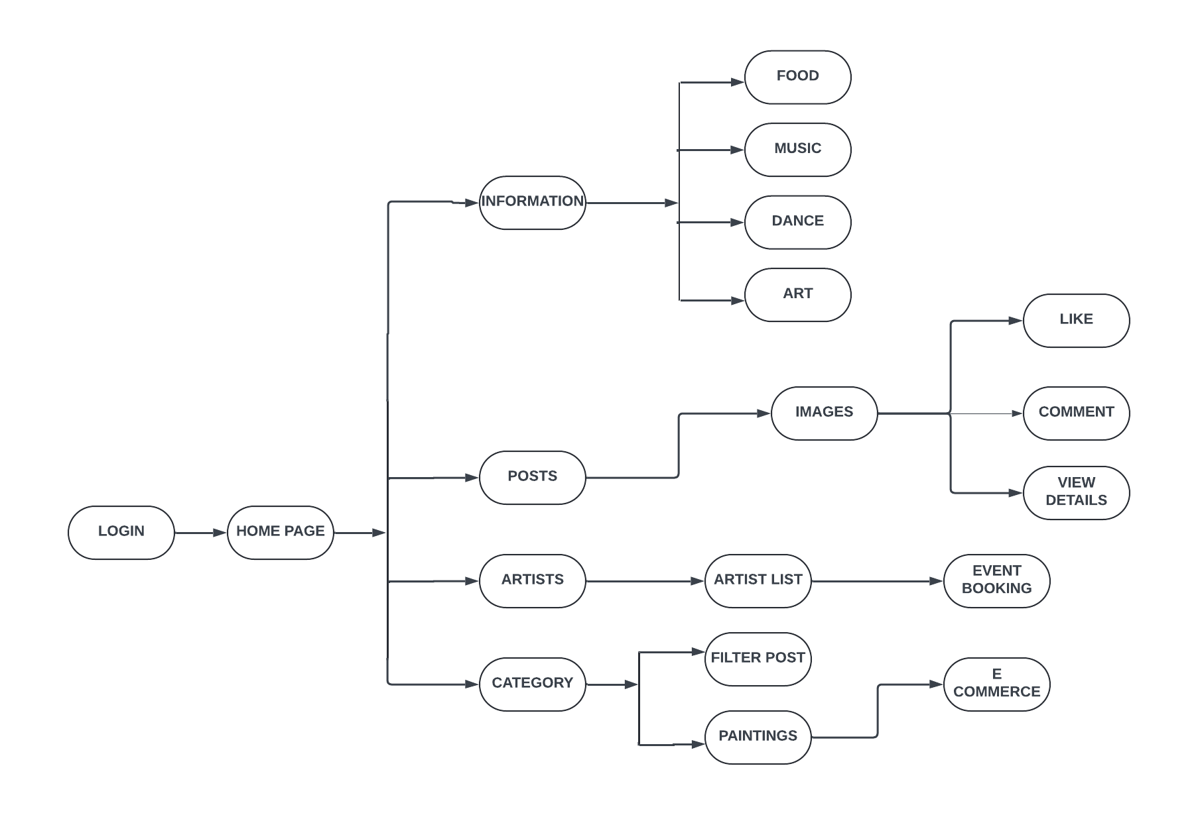
FLOW DIAGRAM

Slide 9
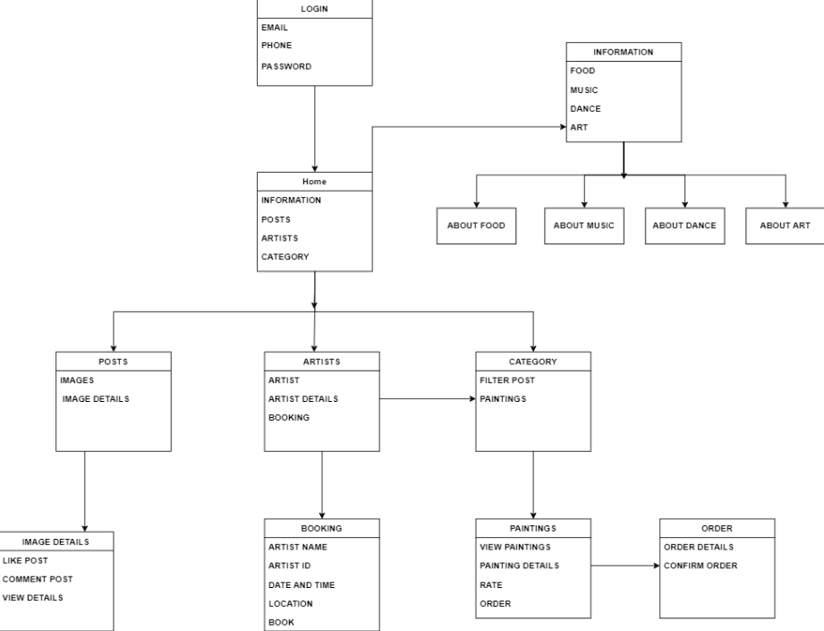
SYSTEM ARCHITECTURE

Slide 10
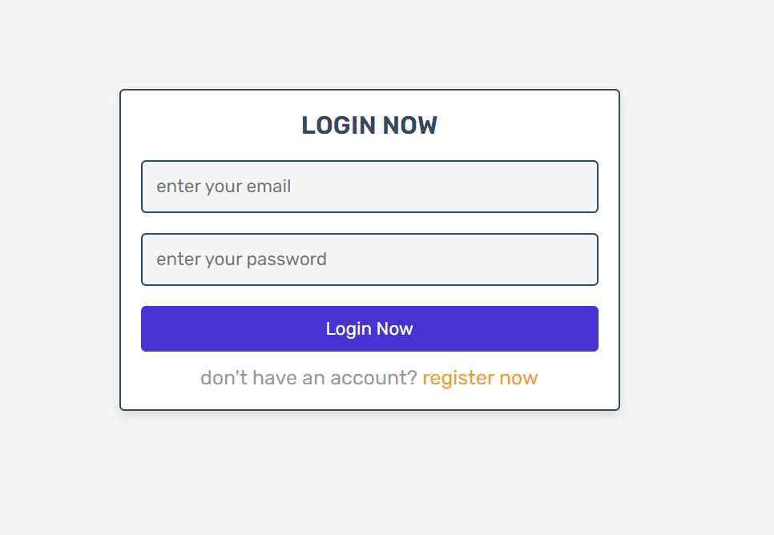
OUTPUTS

Slide 11
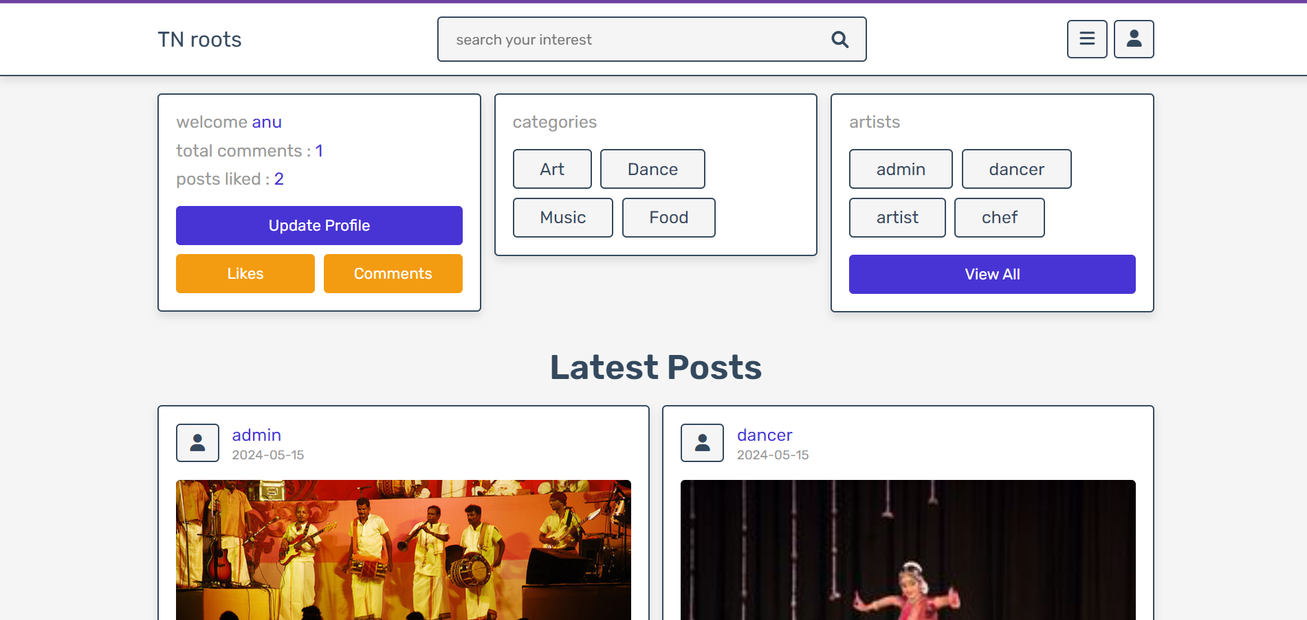
OUTPUTS

Slide 12
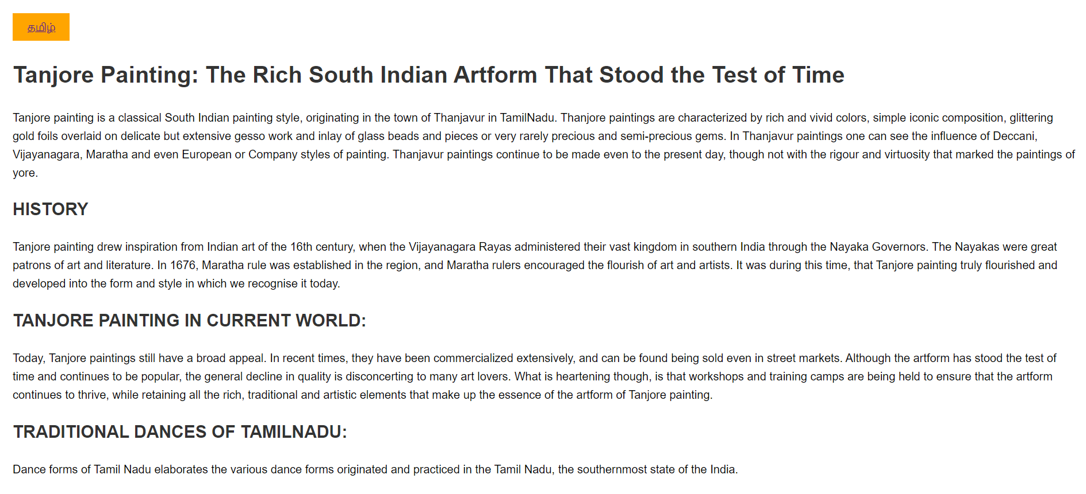
OUTPUTS

Slide 13
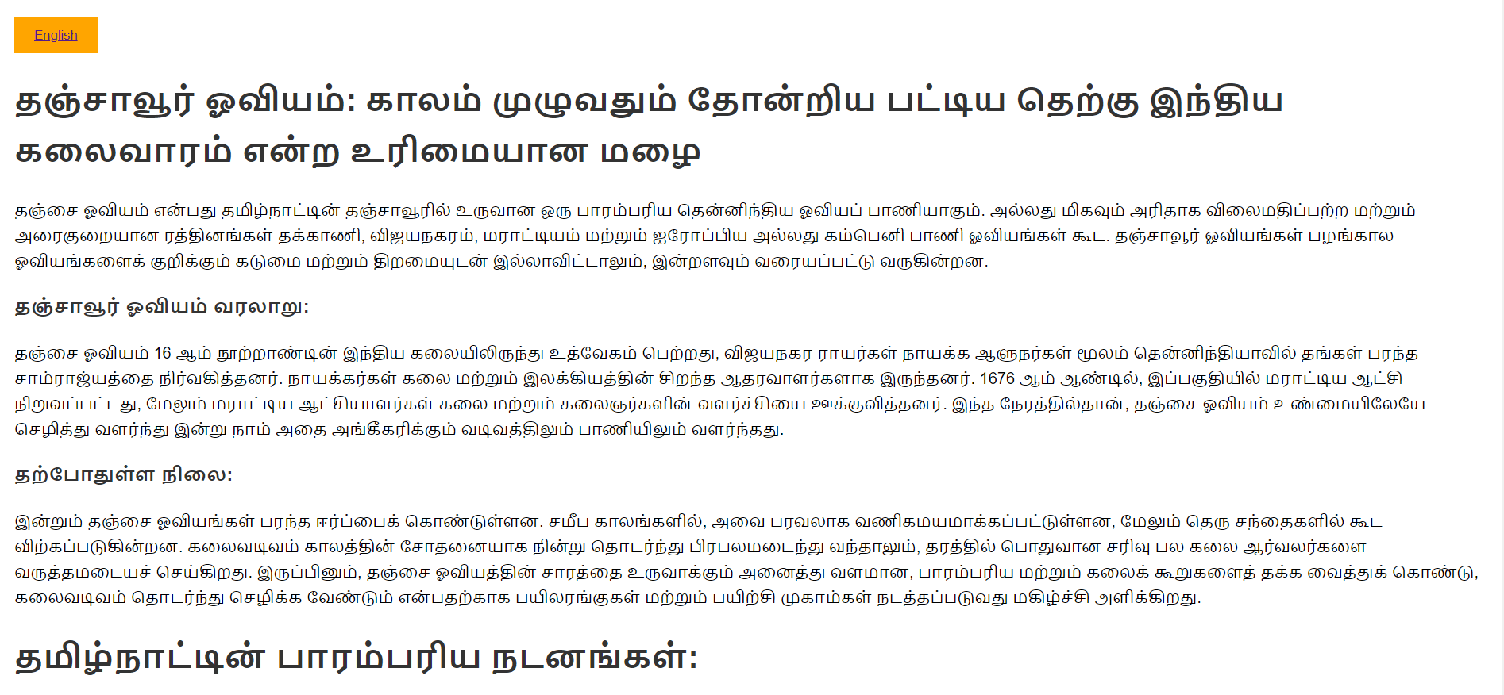
OUTPUTS

Slide 14
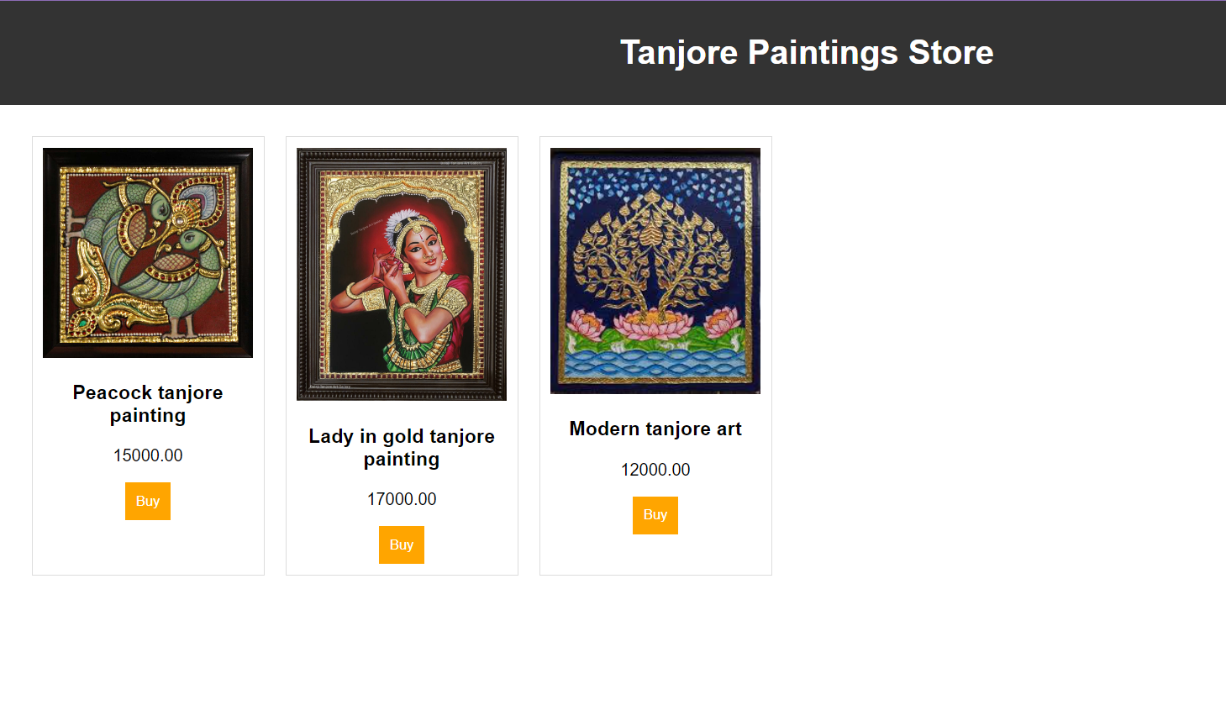
OUTPUTS

Slide 15
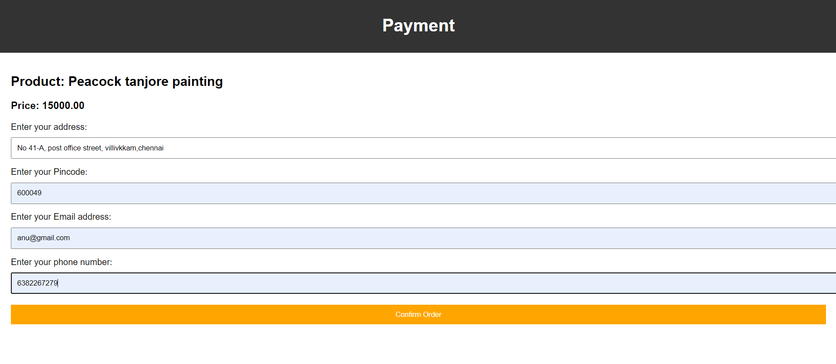
OUTPUTS

Slide 16
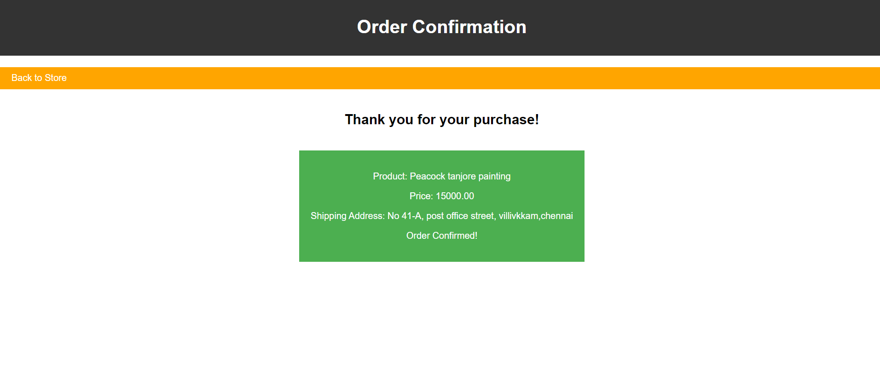
OUTPUTS

Slide 17
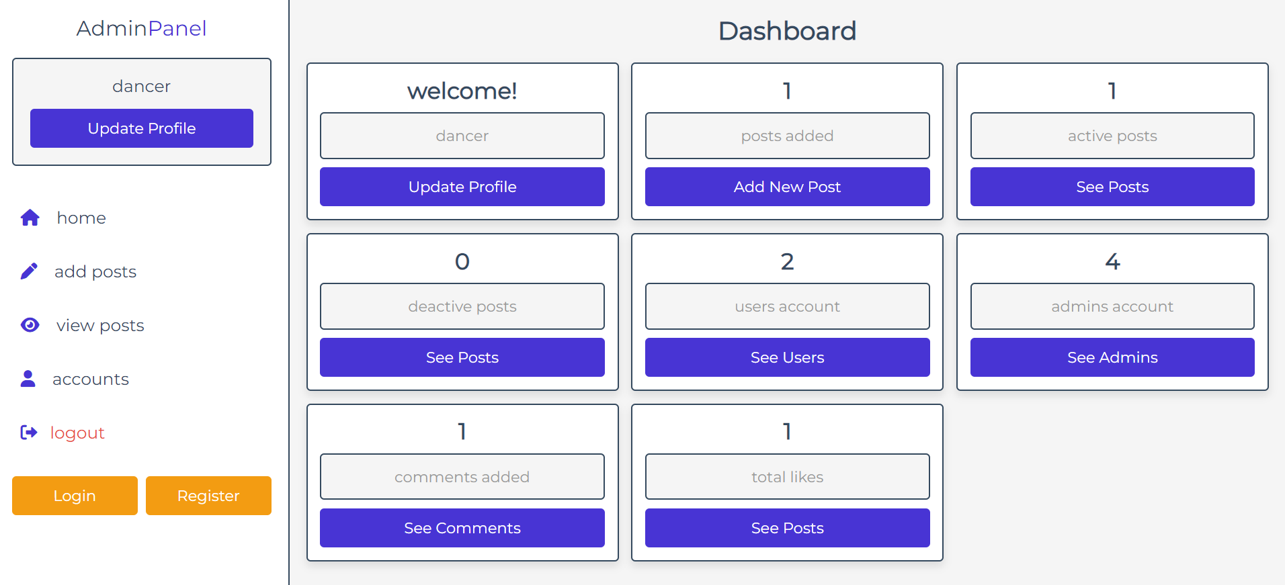
OUTPUTS

Slide 18
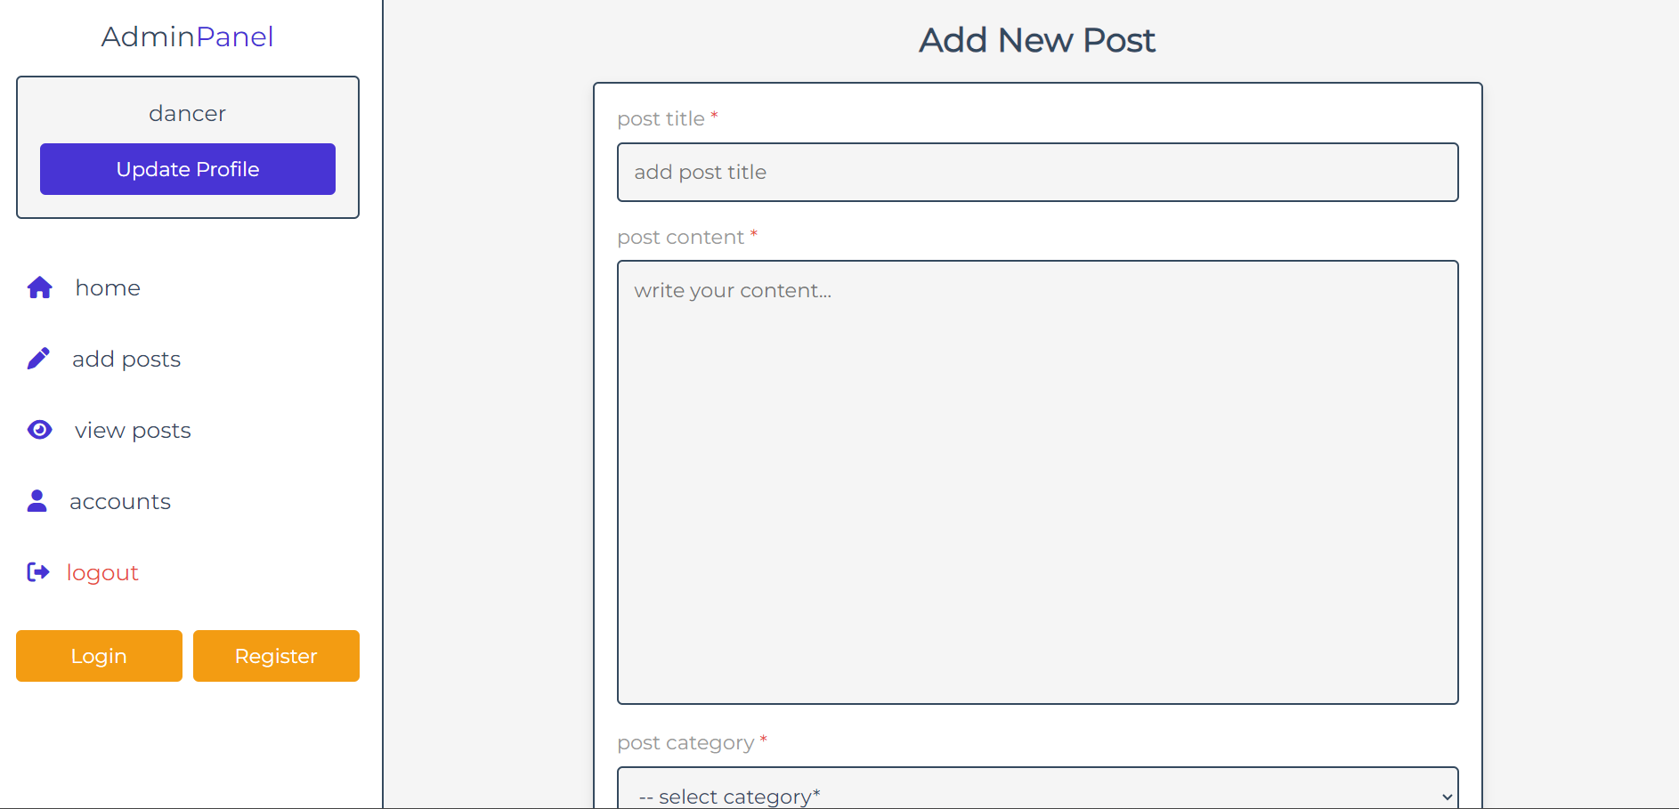
OUTPUTS

Slide 19
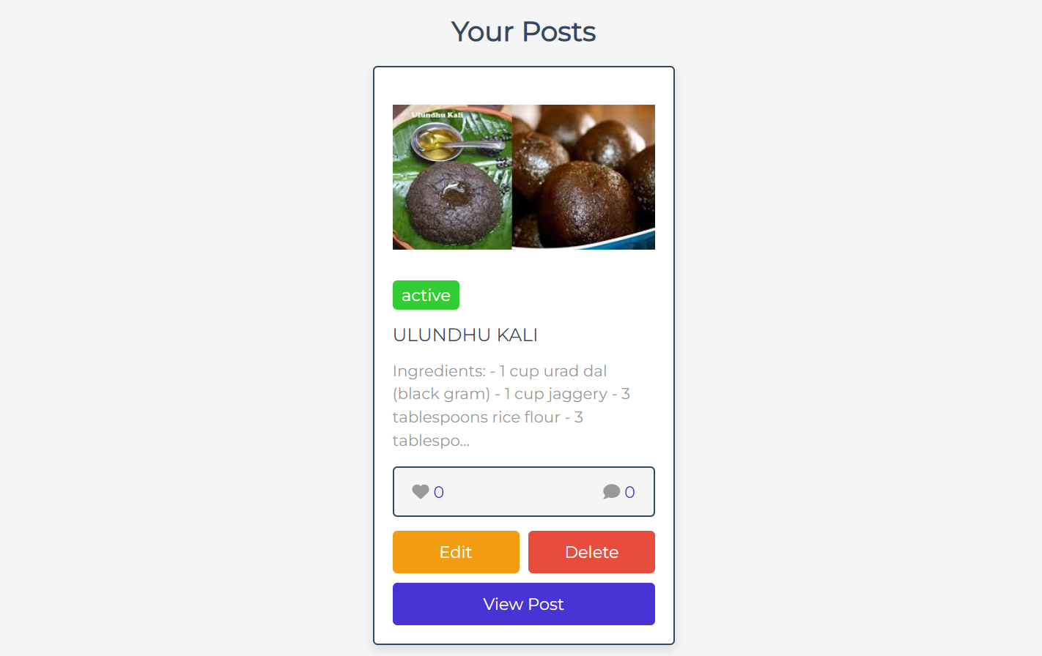
OUTPUTS

Slide 20
CONCLUSION AND FUTURE WORKS
In the end, this project serves as a stepping stone for culture revitalization.
In future, there can be lingual translation of every post for better reach.
Tourism booking for heritage sites can be made so that it improves tourism and serves as platform for various cult people to learn about the state’s artforms.
Online classes and courses can be introduced for further more people to learn and inculcate.

Slide 21
THANK YOU

